Slide 1

Commission Meeting
Local Agency Formation Commission
San Diego County
LAFCO
A Subdivision of the State
October 7, 2024

Slide 2

Item 7b | Proposed “O’Ryan – Calavo Drive Change of Organization”
BACKGROUND
Vacant 0.30-acre parcel within Spring Valley
Plans to develop SFR + ADU
Annexation & SOI (+) amendment to Otay WD for wastewater services

Slide 3

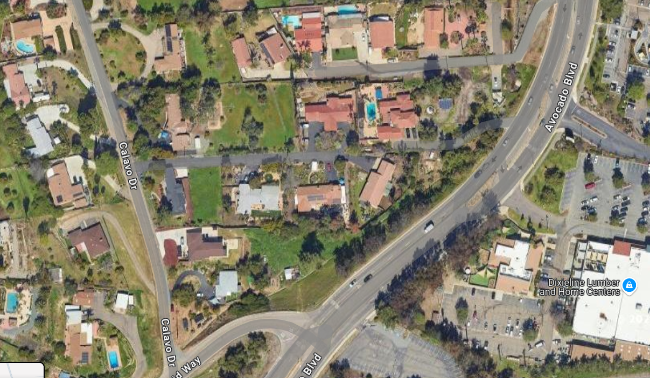
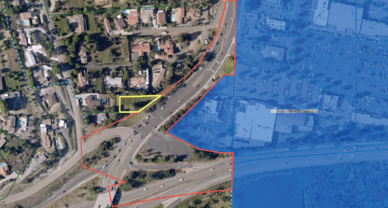
Item 7b | Proposed “O’Ryan - Calavo Drive Change of Organization”
Otay WD Sewer Improvement District
Avocado Blvd.
Otay WD Service Boundary

Slide 4

Item 7b | Proposed “O’Ryan - Calavo Drive Change of Organization”
Qualifiers & Recommendations
Qualifiers
Sphere of influence amendment needed
Policy L-107 (MSR 5+ years old)
Waiver is appropriate, modest project size
Recommendations
a) Approve proposal w/modification & suggested SOI amendment
b) Waive Policy L-106
c) Approve fee waiver & reimburse applicant for SOI amendment

Slide 5
Item 8a | Review of Legislative Policy L-106
(Conducting Municipal Service Reviews)
Key Purposes of an MSR
1. LAFCOs must use municipal service reviews to inform updates to local agencies’ spheres of influence and plan for potential jurisdictional changes over the next five years.
2. Municipal service reviews inform LAFCO’s evaluations of actual jurisdictional change proposals brought forward over the following five-year period.
3. LAFCOs may also use the reviews to initiate their own jurisdictional change proposals for forming, consolidating, merging, or dissolving special districts, if consistent with recommendations.

Slide 6
Item 8a | Review of Legislative Policy L-106
(Conducting Municipal Service Reviews)
Determinations cover Statutory Factors (56430.a)
1. Growth and population projections for the affected area
2. The location and characteristics of any disadvantages unincorporated communities within or contiguous to the sphere of influence
3. Present and planned capacity of public facilities, adequacy of public services, and infrastructure needs or deficiencies including needs or deficiencies related to sewers, municipal and industrial water, and structural fire protection in any disadvantaged, unincorporated communities within or contiguous to the sphere of influence.

Slide 7
Item 8a | Review of Legislative Policy L-106
(Conducting Municipal Service Reviews)
Determinations cover Statutory Factors (56430.a)
4. Financial ability of agencies to provide services
5. Status of, and opportunities for, shared facilities.
6. Accountability for community service needs, including governmental structure and operational efficiencies.
7. Any other matter related to effective or efficient service delivery, as required by commission policy

Slide 8
Item 8a | Review of Legislative Policy L-106
(Conducting Municipal Service Reviews)
Baseline Standards Outlined in L-106
The Commission will maintain a rolling five-year study schedule for municipal service reviews, starting work once a specific study is added to the workplan
Staff will attend no less than one public meeting of each affected agency to advise and present the MSR and solicit feedback.
A public draft of the MSR with recommendations will be prepared by staff for Commission discussion at a publicly noticed meeting.
A public comment period of no less than 45 days will be provided for the draft.
A noticed hearing will be held on the final report, requiring the Commission to formally accept it and adopt a resolution with necessary determinations (56430.a.).

Slide 9
Item 8a | Review of Legislative Policy L-106
(Conducting Municipal Service Reviews)
Commission Review of L-106
Review and Discuss
Provide staff with input and direction

Slide 10

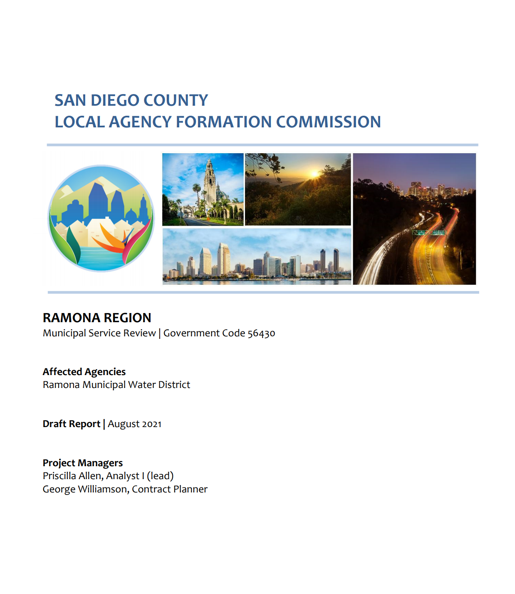
Item 8b | MSR of Wholesale Water Agencies Status Update
Completed
Outreach to MWD, CWA, and member agencies regarding intent to being the MSR process
  Includes speaking to each Board of Directors
Financial data requests to MWD and CWA for the past fifteen (15) years
Financial analysis of both wholesalers
Completed Overview, Background, Boundaries, Demographics, and Organization components of MSR
Held two (2) Ad Hoc Work Group meetings consisting of CWA member agency General Managers to receive feedback on potential topics

Slide 11
Item 8b | MSR of Wholesale Water Agencies Status Update
Potential Topics
Water supply and demand
Finances
Water Infrastructure
External Issues
  Climate change resilience of water supply
  Governance, including Board structure; voting weights
  Relationships in generating demand forecasts
  Opportunities for increased cooperation and exchanges between SDCWA and MWD at the member agency level
  Water for agriculture in San Diego County
  Water affordability in San Diego County
  Opportunities for increasing fixed revenues

Slide 12

Item 8b | MSR of Wholesale Water Agencies Status Update
Ad Hoc Working Group
Helix Water District | City of Oceanside
City of San Diego | Olivenhain Municipal Water District
Otay Water District | Padre Dam Municipal Water District
Ramona Municipal Water District | San Diego County Water Authority
Santa Fe Irrigation District | Valley Center Municipal Water District
Yuima Municipal Water District

Slide 13
Item 8b | MSR of Wholesale Water Agencies Status Update
Next Steps
Continue to monitor efforts of wholesale agencies
  CWA Long-Range Financing Plan development delayed
  Awaiting report to rating agencies
Work with Dr. Hanemann on development of analysis of topics to be presented to the Working Group

Slide 14
Item 8c | FY25 Appointments to the California Association of Southern Region LAFCOs
The Association consists of six Southern California LAFCOs:
  Imperial
  Los Angeles
  Orange
  Riverside
  San Bernardino
  San Diego
The Association provides legislative support and educational resources to its members and functions solely to share information and improve collaboration among its member agencies.
RECOMMENDATION
Establish two appointments:
  One regular member
  One alternate member

