Slide 1
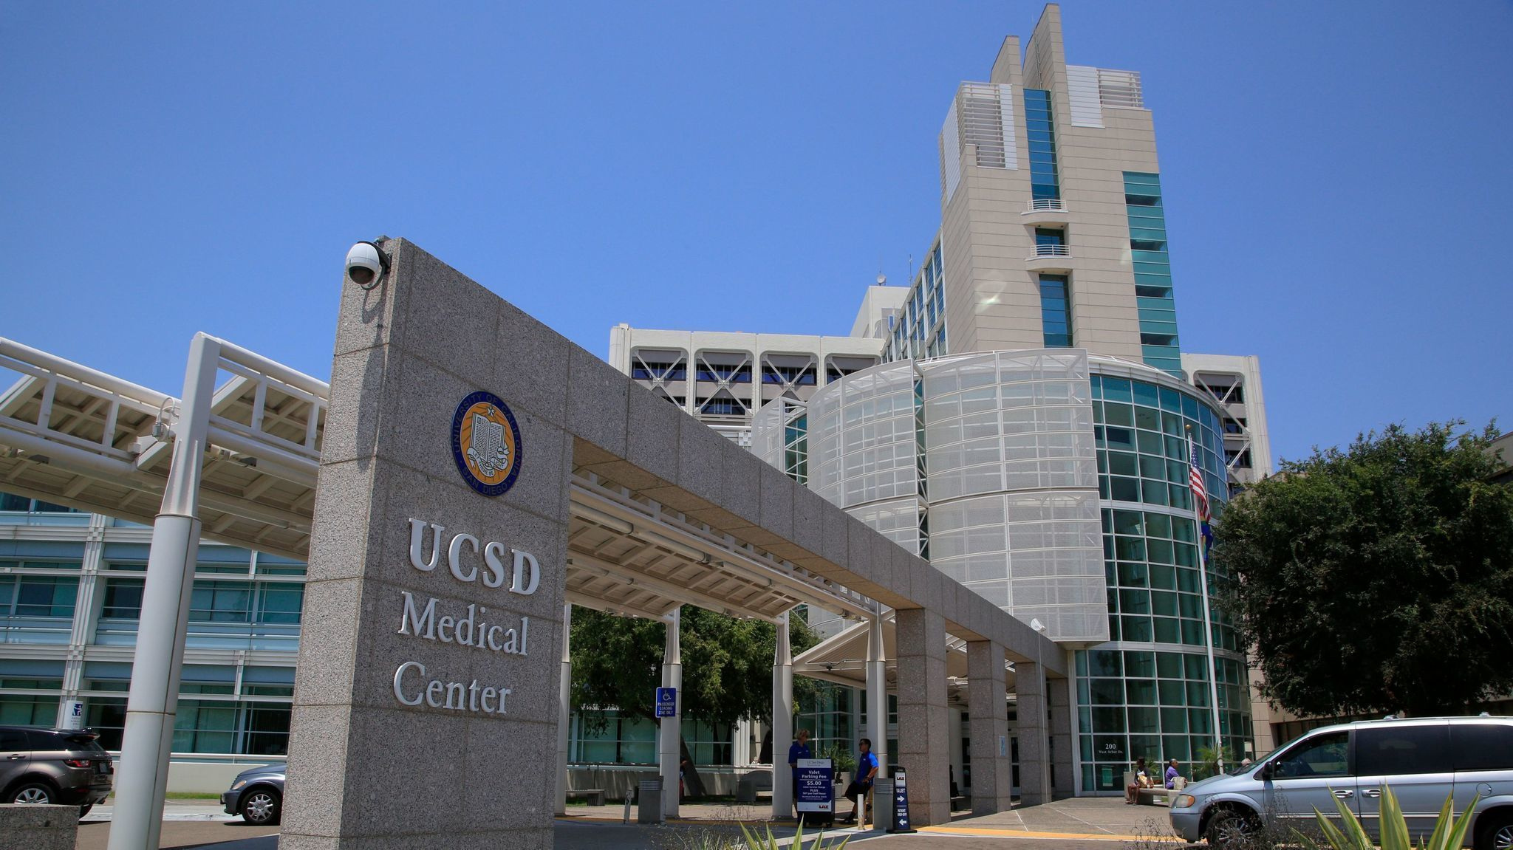
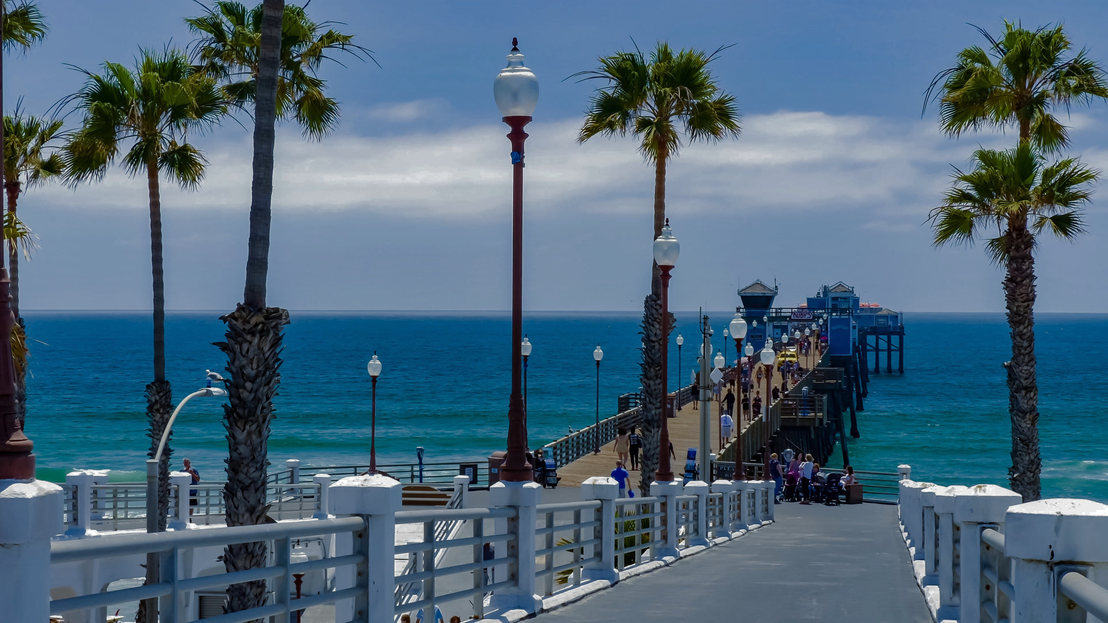


SAN DIEGO LAFCO
Proposed Final Draft: Oceanside Region
Municipal Service Review
11/4/2024

Slide 2
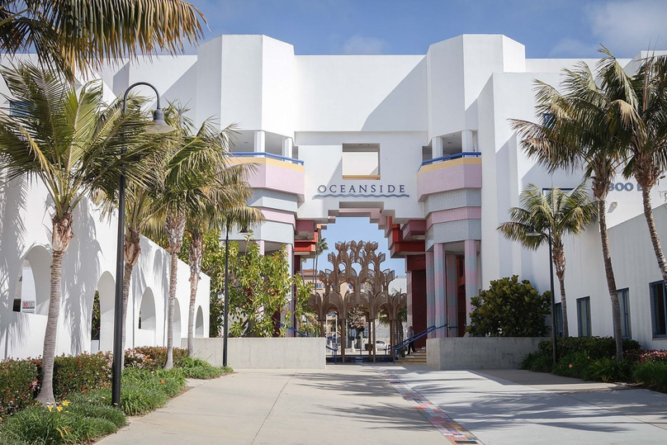

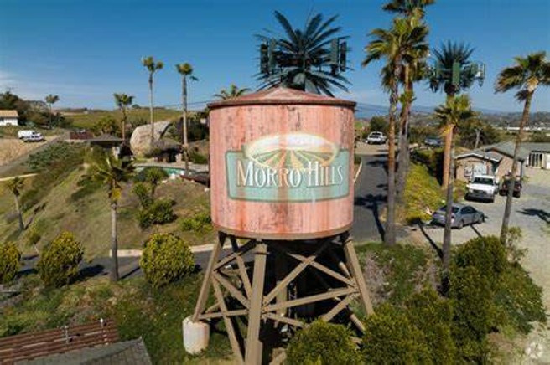
1
Subject Agencies
2
2
3
  City of Oceanside
  Oceanside Small Craft Harbor District
  Morro Hills Community Services District
4
5
6
7
8
9
10
11
12
1
2
3
13

Slide 3
1
MSR Structure
2
3
3
Independent evaluation of a) availability, b) demand, + c) performance
3 Explicit Uses:
  Guide LAFCO’s task in statute to review and update local agency’s spheres every five years setting immediate eligibility for annexations & out-of-agency services
  Inform LAFCO’s decision-making process in taking up any actual jurisdictional changes that may be proposed in the region over the next five-year period
  Authorize – if warranted – an action by LAFCO to initiate its own proposals specific to forming, consolidating, and/or dissolving special districts
4
5
6
7
8
9
10
11
12
13

Slide 4
1
Key Themes + Conclusions
2
3
  Introductory MSR
  Adjusting Growth: (Changes in Demographics, Market Conditions, and Community Empowerment) *
  Adjusting Growth: (Effects on Housing Affordability) *
  Variations in Fiscal Health + Ability to Navigate Stresses
  Adequate Municipal Service Capacities with a Qualifier
  City Role as an (ideal) Urban Center
  Unease within the Oceanside Small Craft Harbor District *
  Proceeding with Limited Sphere Updates with Special Study Areas *
4
4
5
6
7
8
9
10
11
12
13
* = changed or edited language

Slide 5
1
Changes to Key Themes + Conclusions
2
3
  Introductory Municipal Service Review
    Establish baseline information to track and measure service functions going forward
  Adjusting Growth: (Changes in Demographics, Market Conditions, and Community Empowerment) *
    Reasons why population growth has slowed significantly
4
5
5
6
7
8
9
10
11
12
13
* = changed or edited language

Slide 6
1
Changes to Key Themes + Conclusions
2
3
3. Adjusting Growth: (Effects on Housing Affordability) *
    Median home price skyrocketed from $195,800 to $784,800 over 20 years.
    Challenges building affordable housing
4. Variations in Fiscal Health + Ability to Navigate Stresses
    City stabilized finances after years of shortfalls, due in part to 2018 ballot Measure X (half-cent sales tax)
    SCHD faces long-term maintenance challenges due to decades of deferred upkeep on capital assets
    Morro Hills CSD maintained positive financial position but lacks detailed assessments and planning for its roadway system, posing emerging financial risks
4
5
6
6
7
8
9
10
11
12
13
* = changed or edited language

Slide 7
1
Changes to Key Themes + Conclusions
2
3
5. Adequate Municipal Service Capacities w/Qualifier
    All three agencies have sufficient capacities within core municipal functions to meet current & future demands,
6. City Role as an (ideal) Urban Center
    City is well-positioned to accommodate growth as key urban center in North County
4
5
6
7
7
8
9
10
11
12
13
* = changed or edited language

Slide 8
1
Changes to Key Themes + Conclusions
2
3
7. Unease within the Oceanside Small Craft Harbor District *
    SCHD’s nearly 1,000 boat slip users expressing concerns about public safety and financial management
8. City Role as an (ideal) Urban Center
    LAFCO should conduct limited updates to the three Oceanside agencies & defer comprehensive changes to next MSR cycle
4
5
6
7
8
8
9
10
11
12
13
* = changed or edited language

Slide 9
1
Recommendations
2
3
  LAFCO Should Prioritize Future Growth Towards Oceanside *
    LAFCO & City should continue coordination in support of City’s General Plan
  LAFCO Should Work with SANDAG on Buildout Estimates
  LAFCO + County Should Identify and Map Wells & Septic Systems
  LAFCO Should React to Measure X if Not Extended *
    Results available as early as Wednesday
  LAFCO Should Punt on Addressing Mutual Water Companies
4
5
6
7
8
9
9
10
11
12
13
* = changed or edited language

Slide 10
1
Recommendations
2
3
6. City Should Revisit Payment Plan for Harbor’s Patrol Vessel
7. Morro Hills Should Explore Contracting w/City or County
8. City Should Explore Expansion of Re-Beach Program – JPA or District…
9. Harbor District Should Publicly Distinguish Itself *
    SCHD is its own legal entity, but not so easy to track by LAFCO or general public
10. Harbor District Should Formalize Staff Support with the City *
    Existing informality between City & SCHD regarding roles & responsibilities amongst staff, supplies, and resources – an MOU would be helpful.
4
5
6
7
8
9
10
10
11
12
13
* = changed or edited language

Slide 11
1
Recommendations
2
3
11. Harbor District Should Deactivate Patrol and Rescue Function *
    Patrol and rescue services in SCHD need to become more clearly defined
12. LAFCO Can Consider Governance Study on Harbor District Options *
    Community Interest in exploring feasibility of SCHD going independent
13. Limited Sphere Update for City/Harbor with Special Study Area *
    Proposed Special Study Area (2 non-contiguous DUCs within Vista)
14. Sponsor Legislative Change for Morro Hills to Reduce Board to 3
15. Morro Hills Should Revisit Speed Limit on Sleeping Indian Road
4
5
6
7
8
9
10
11
11
12
13
* = changed or edited language

Slide 12
1
Recommendations
2
3
16. Morro Hills Should Explore Adjacent Interest in Annexations
17. LAFCO should help coordinate discussions w/CSD & County Sheriff for traffic
enforcement
18. Limited Sphere Update for Morro Hills with Special Study Area
19. LAFCO should prioritize proposals in Oceanside that promote Environmental
Justice *
4
5
6
7
8
9
10
11
12
12
13
* = changed or edited language

Slide 13
SAN DIEGO LAFCO
Proposed Final Draft: Oceanside Region
Municipal Service Review
11/4/2024

Slide 14

SAN DIEGO LAFCO
Proposed “Dragovic-Sunset Drive
Out-of-Agency Wastewater Services”
11/4/2024

Slide 15
Background
  Location: 1678 Sunset Drive
  1.25-acres in Unincorporated
  Within City of Vista’s SOI
  (1) Single-Family Residence
1
2
2
3
4
5

Slide 16
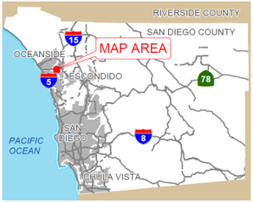
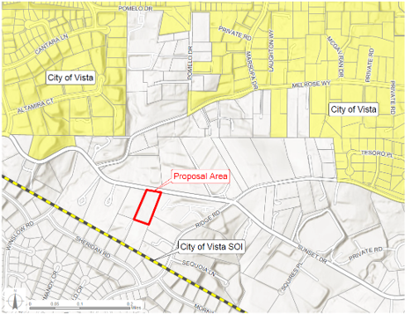
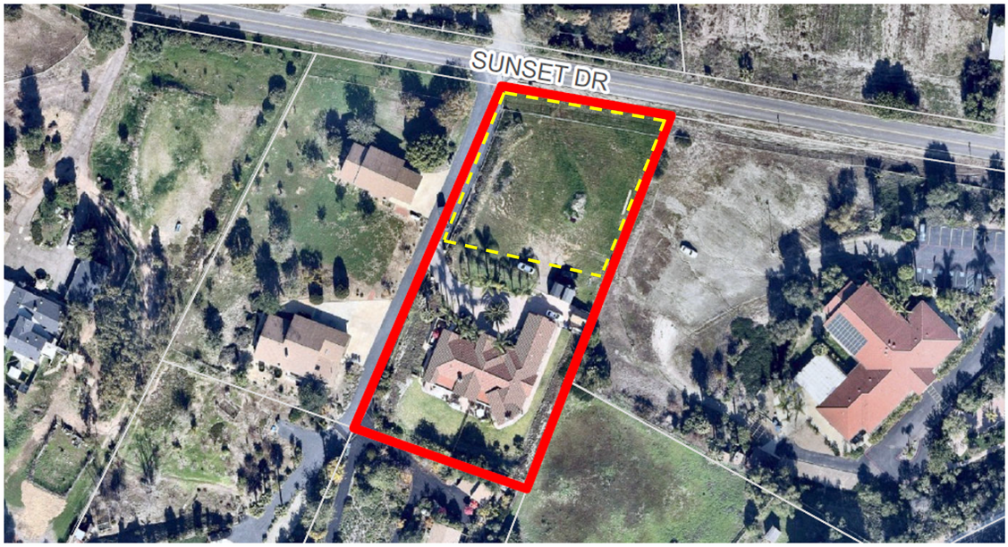
1678 Sunset Dr
  1.25 Acres
  (1) SFR (4,290 square-ft)
  Subdivision Application
1
2
3
3
4
5

Slide 17
Recommendations
  Approve the requested out-of-agency wastewater service authorization allowing City of Vista to serve the affected territory
  Authorize the EO to file CEQA Notice of Exemption
1
2
3
4
4
5

Slide 18
SAN DIEGO LAFCO
Proposed “Dragovic-Sunset Drive
Out-of-Agency Wastewater Services”
11/4/2024

Slide 19
SAN DIEGO LAFCO
Proposed Amendments to Legislative
Policy L-106 (Conducting Municipal Service Reviews)
11/4/2024

Slide 20
Four Proposed Amendments
1
2
1
2
Reference to the “Rolling” Feature of the Five-Year Study Schedule
2
Addressing Quantitative Measurements
3
4
5
3
4
6
Formalizing and Expanding Subject Agencies’ Review of Draft Reports
7
Formalizing Public Hearing for Draft Reports
8

Slide 21
Reference to the “Rolling” Feature of the Five-Year Study Schedule
1
2
2. Timing
    The Commission will maintain a rolling five-year study schedule for municipal service reviews to provide advance notice of timing to local agencies, the public, and other stakeholders as well as encourage project syncing whenever practical.
    The Commission will consult the rolling five-year study schedule in initiating specific municipal service reviews through the annual workplan process.
3. Funding
    The Commission will be responsible for funding municipal service reviews calendared in the rolling five-year study schedule and subsequently added to adopted annual workplans.
3
3
4
5
6
7
8

Slide 22
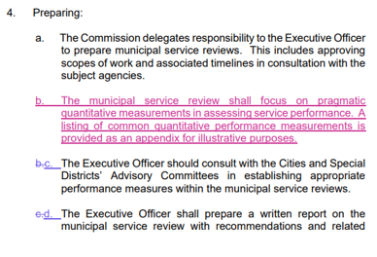
Addressing Quantitative Measurements (Appendix)
Demographics Metrics
  Residential Population Estimates
  Housing Units, Types, Costs, and Vacancy Rates
  Age Distribution
  Income Characteristics and Socioeconomic Indicators
  Unhoused Needs
  Environmental Justice Considerations
Cost-Effectiveness Metrics
  Cost per Unit of Service
  Cost-Benefit Analysis
  Economies of Scale
1
2
3
Efficiency Metrics
  Productivity
  Utilization Rates
  Turnaround Times
4
4
5
Fiscal Metrics
  Budget and Actuals
  Funds and Balances
  Audited Financial Statements
  Employee Pensions and Related Obligations
Service Delivery Metrics
  Response Times
  Service Levels
  Customer Satisfaction
6
7
8
Resource Utilization Metrics
  Staffing Levels
  Equipment and Infrastructure
  Operating Costs
Benchmarking
  Comparison to Other Jurisdictions
  Industry Standards

Slide 23
Formalizing and Expanding Subject Agencies’ Review of Draft Reports
1
2
  Providing full draft report with recommendations
  Providing 60-day review and comment period ahead of draft presentation
  Comments received will accompany draft report
3
4
5
e. The Executive officer shall allow all subject agencies an opportunity
to review a complete draft report on the municipal service review
with recommendations as part of the preparation process and before
making the draft publicly available. This review period shall extend to
no more than 60 days. Any written comments received from the
subject agencies shall accompany the publication of the draft report.
5
6
7
8

Slide 24
Formalizing Public Hearing for Draft Reports
1
2
3
4
6. Commission Action:
e. The Commission will receive all draft reports on the municipal service
reviews as part of voluntarily noticed public hearings. The
Commission will review the draft reports for purposes of advising
staff on any areas meriting additional analyses before or in step with
proceeding with the public review periods.
5
6
6
7
8

Slide 25
Commission Review of L-106
1
  Discussion
  Consider the alternative actions
  Staff Recommendation:
    Approve the proposed amendments to L‐106 as shown in track‐change format as Attachment Two with any desired changes as well as set an immediate effective date.
2
3
4
5
6
7
7
8

Slide 26
SAN DIEGO LAFCO
Proposed Amendments to Legislative
Policy L-106 (Conducting Municipal Service Reviews)
11/4/2024

Slide 27
SAN DIEGO LAFCO
Update: Municipal Service Review
for Healthcare Districts
11/4/2024

Slide 28
Background
  Provided LAFCO Commission with last update in May 2024
  Highlights at that time:
    Embarking on Municipal Service Review for the (4) Healthcare Districts in San Diego County.
    Commission designating the project 1 of 2 ”high priority” projects in the current workplan
    Conducted extensive preliminary outreach from stakeholders
    Met with all (4) CEO’s individually and once collectively
    Attended Board Meetings at all (4) districts to introduce MSR
1
2
3
4
5
6
7

Slide 29
Progress
  Project details have materialized since last update
  Developed New Scope of Work
    Phase 1 – Macro
    Phase 2 – Micro
  Executed contract for nationwide healthcare consulting firm
  Consultant met with each district independently
  Consultant working on their analysis
1
2
3
4
5
6
7

Slide 30
Early Highlights
  Boundaries and Sphere of Influence Updates
  Financial status and solvency of each district
  Governance structure and future models
  Access to care
  Hospital wall (wait) times
  Short and long-term outlooks
  Common theme is all (4) districts embraced a third-party review
1
2
3
4
5
6
7

Slide 31
Next Steps
  Scheduling healthcare consultant to come to San Diego for site-visits
  Anticipate the Consultant to provide us their report by end of year
  Continue engagement and update each District’s Board of Directors
  Early 2025 develop Draft MSR report
  Commission Decision Spring 2025
1
2
3
4
5
6
7

Slide 32
Conclusion
  Questions?
  Comments?
  Feedback?
1
2
3
4
5
6
7

Slide 33
SAN DIEGO LAFCO
Update: Municipal Service Review
for Healthcare Districts
11/4/2024

Slide 34
SAN DIEGO LAFCO
Update: Municipal Service Review
SANDAG
11/4/2024

Slide 35

Background
  SANDAG MSR was included in LAFCO FY 2025 work plan
  LAFCO hired William Fulton Group to assist
  Project is expected to take about a year
1
2
3
4
5

Slide 36
Essential Details
  First-ever MSR of a Council of Governments
  SANDAG performs roles under both state and federal law
  MSR is focused on:
    Transportation Planning
    Housing
    Climate Adaptation
  Not focused on design & construction
1
2
3
4
5

Slide 37
Progress
  Team has done initial literature review and research but is still at the information-gathering stage
  Several meetings with SANDAG so far
  Some scope refinement still necessary
  Draft should be completed by Summer
1
2
3
4
5

Slide 38
SAN DIEGO LAFCO
Update: Municipal Service Review
SANDAG
11/4/2024

Slide 39
SAN DIEGO LAFCO
Report on the 2024 CALAFCO
Annual Conference
11/4/2024

Slide 40
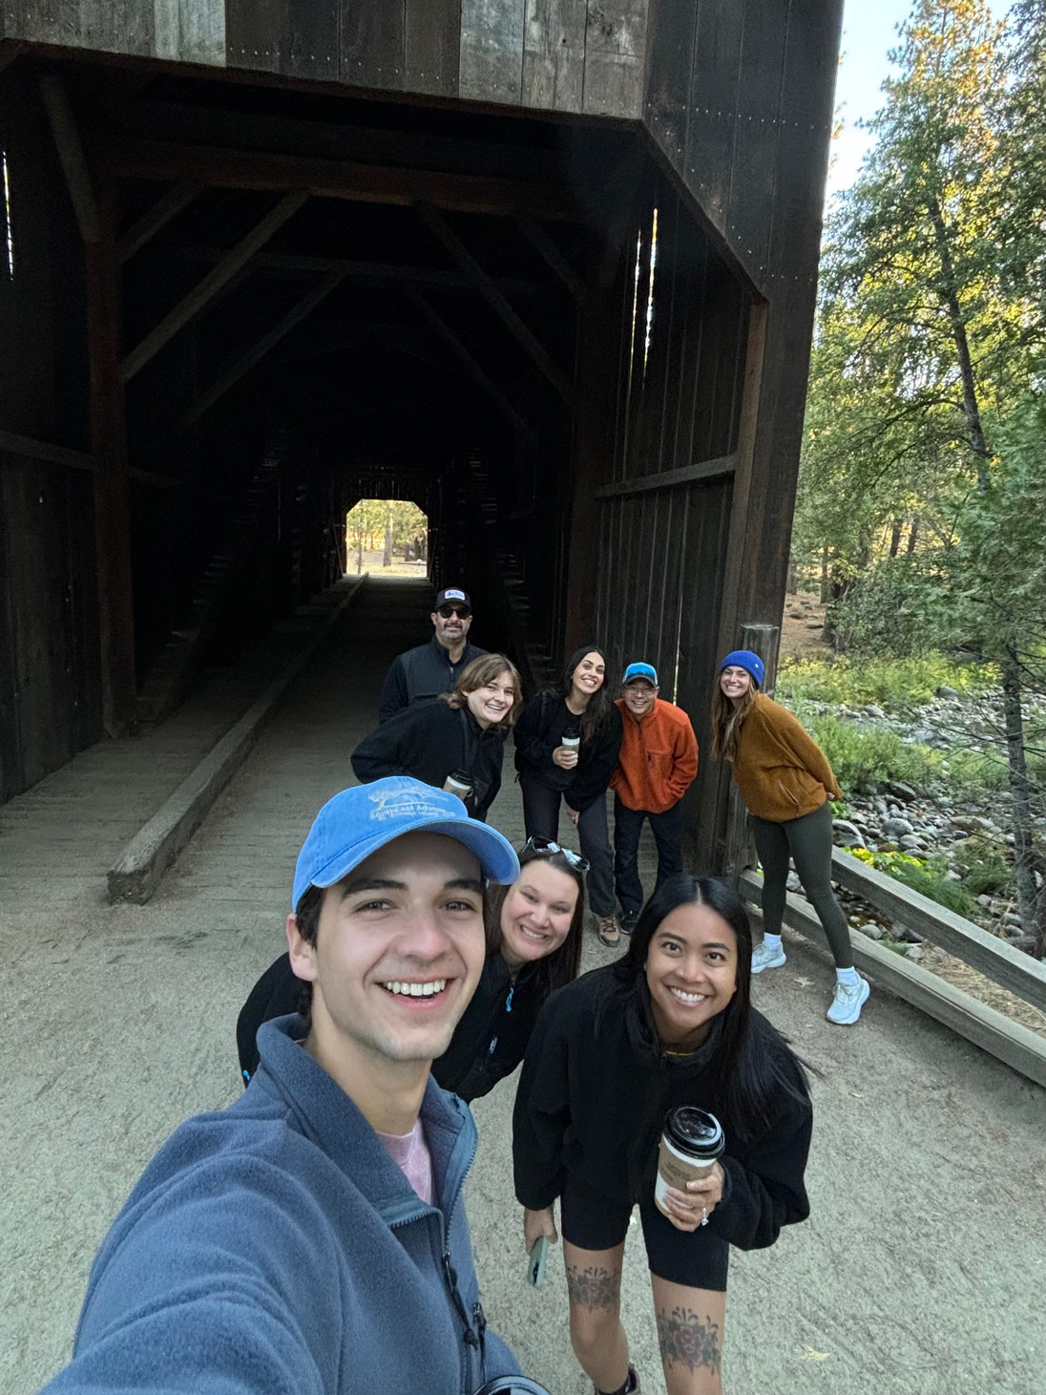
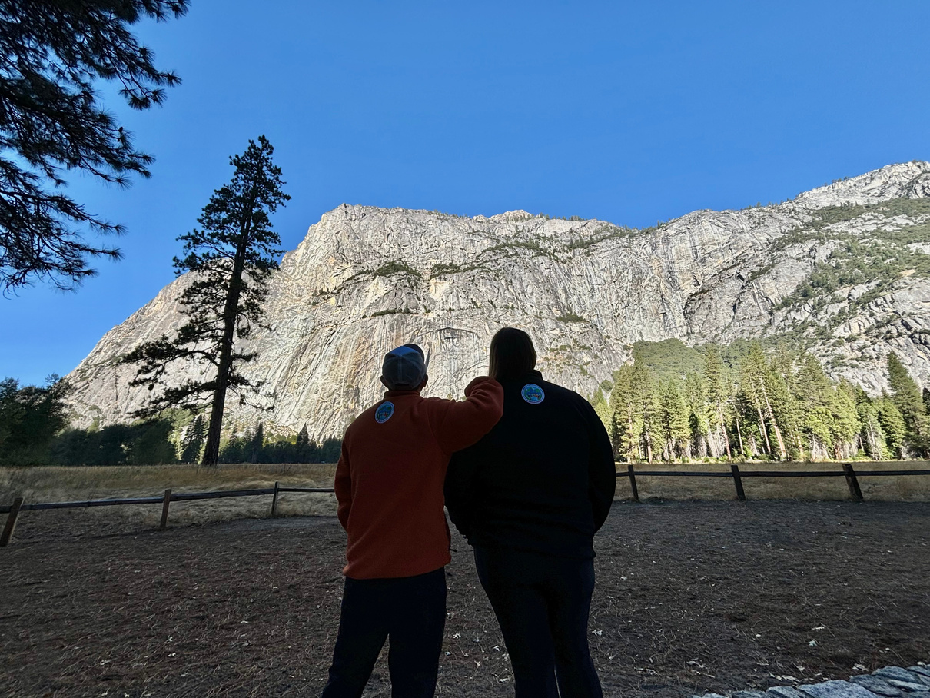
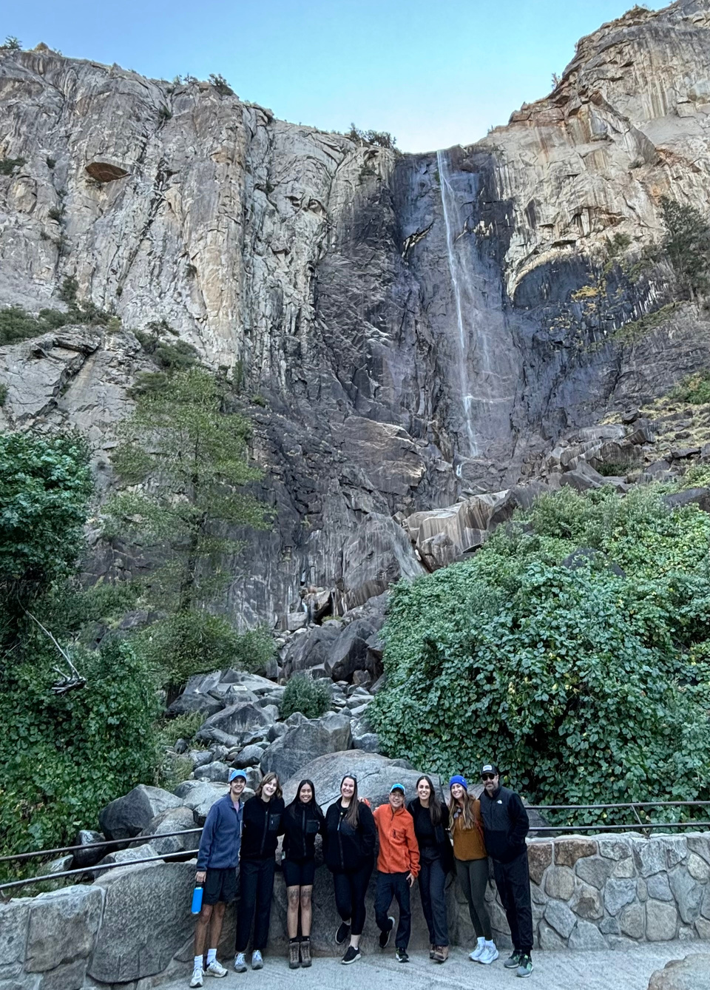

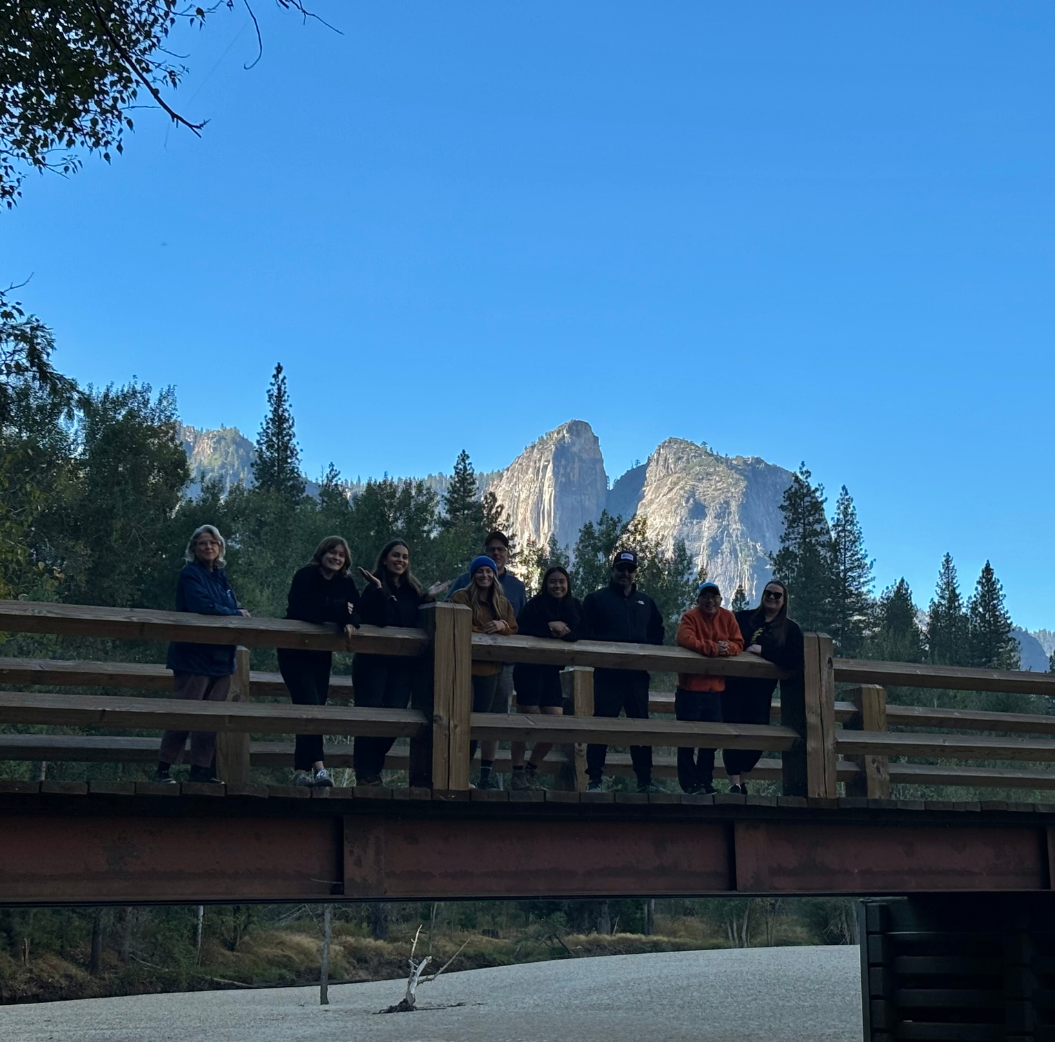

CALAFCO 2024:
YOSEMITE

Slide 41
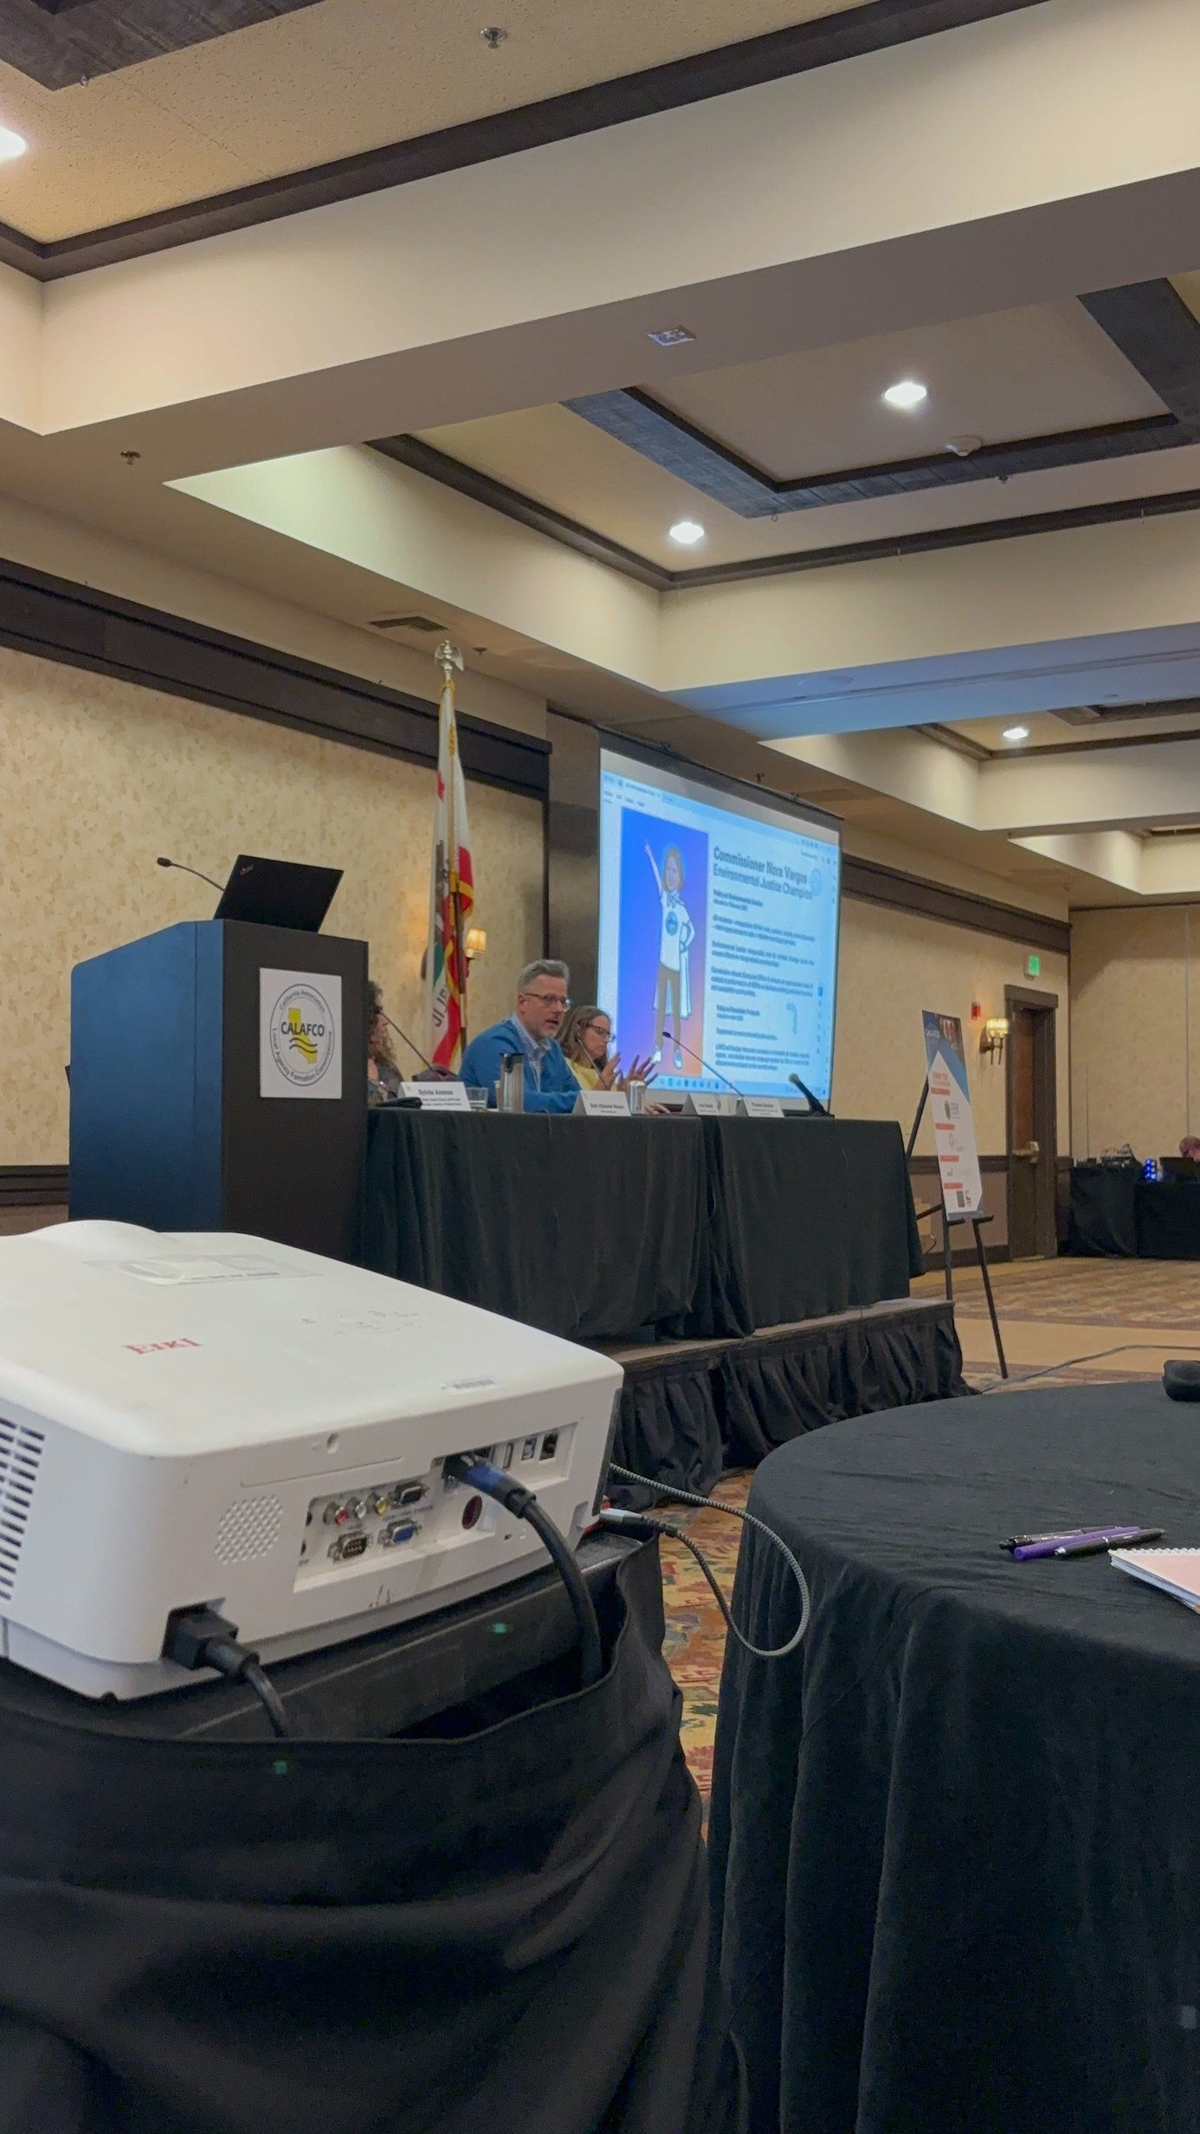
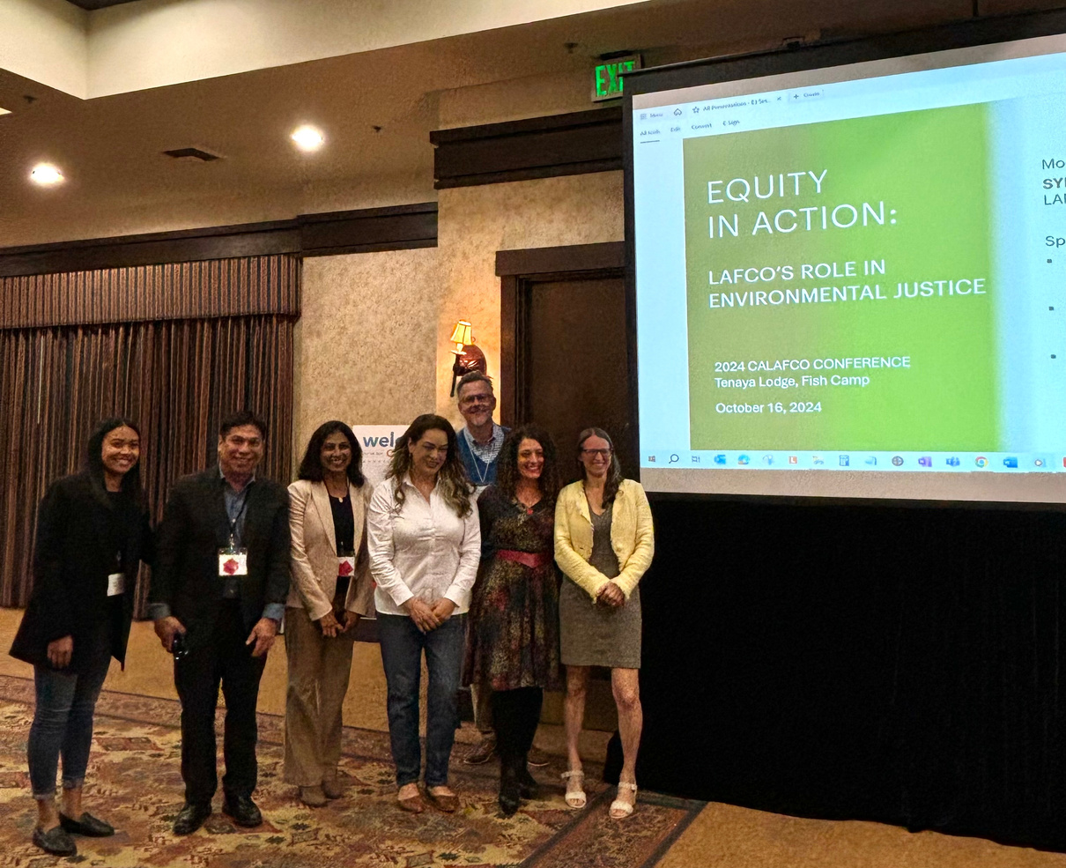

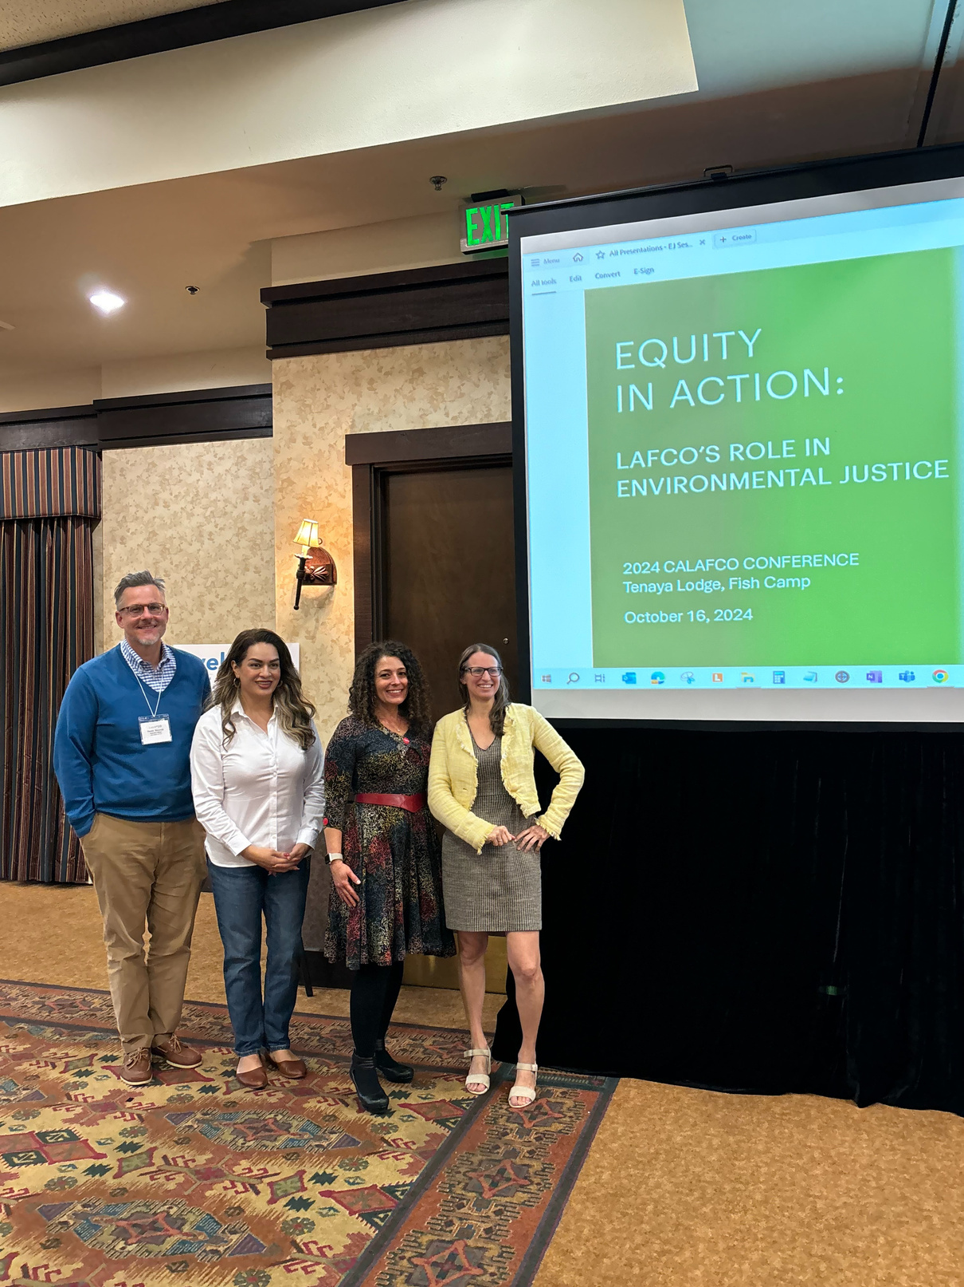

CALAFCO 2024:
YOSEMITE

Slide 42
SAN DIEGO LAFCO
Report on the 2024 CALAFCO
Annual Conference
11/4/2024

